Slide 1

Book My Stay
Your Seamless PG Accommodation Solution
Presented By: Deepak Saini

Slide 2

Project Introduction: Simplifying PG Search
Finding suitable Paying Guest (PG) accommodations can be a daunting task, often involving extensive manual searches and unreliable information. "Book My Stay" addresses this challenge by providing a centralized, efficient platform for users to discover and book PGs effortlessly.
This application serves as a crucial bridge, connecting prospective tenants with available PG listings and streamlining the entire process, making it simple and transparent.

Slide 3



Core Objectives of "Book My Stay"
Simplify PG Search
Facilitate Online Booking
Empower Owners/Admins
Enable users to find accommodations quickly and easily through intuitive search and filtering options.
Provide a seamless process for users to book their preferred PG accommodations directly through the application.
Offer robust tools for PG owners and administrators to efficiently manage listings, bookings, and availability data.

Slide 4
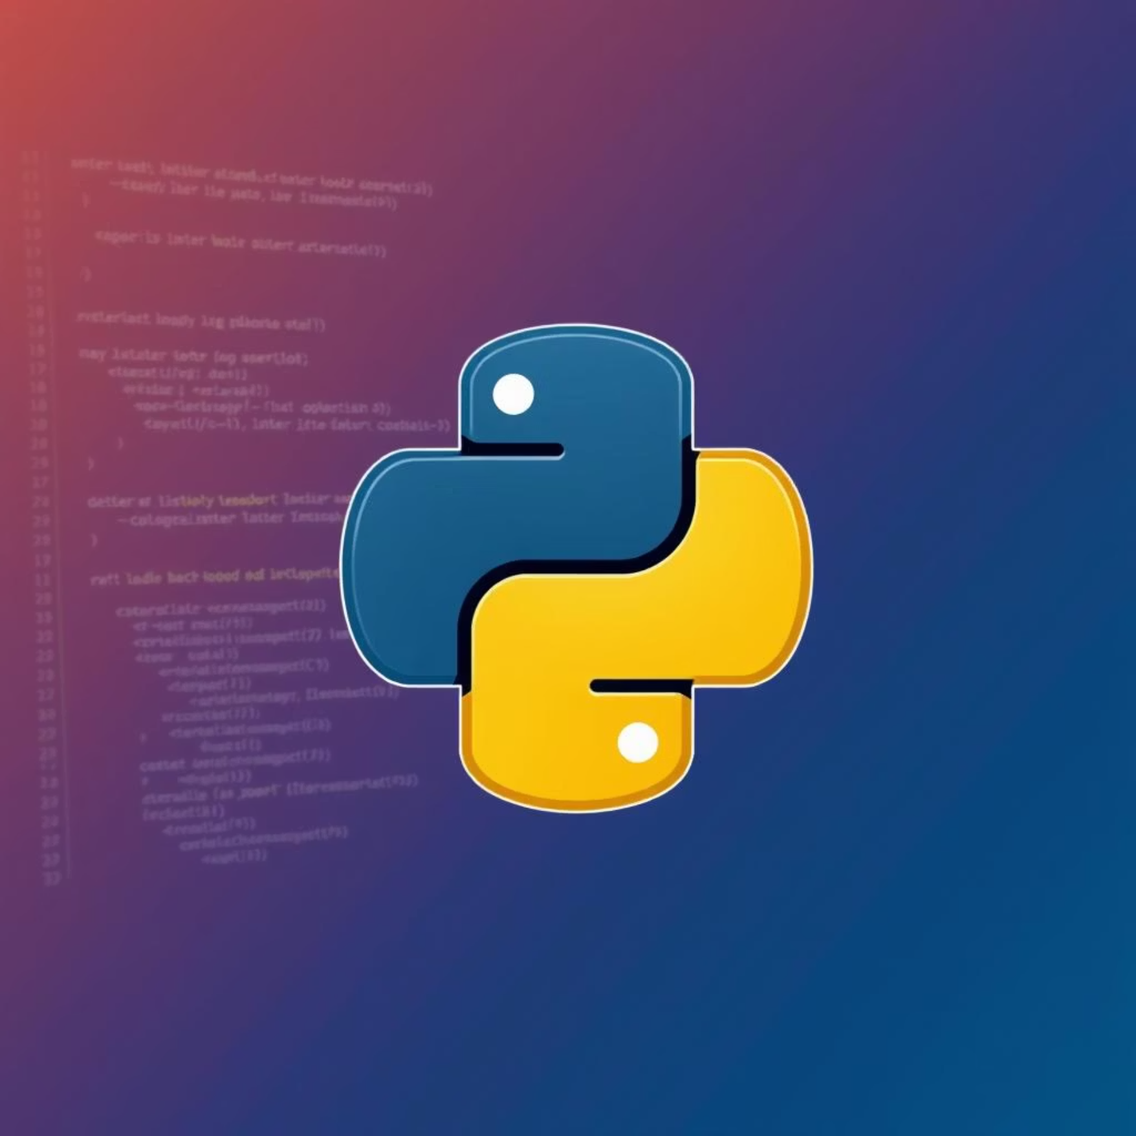
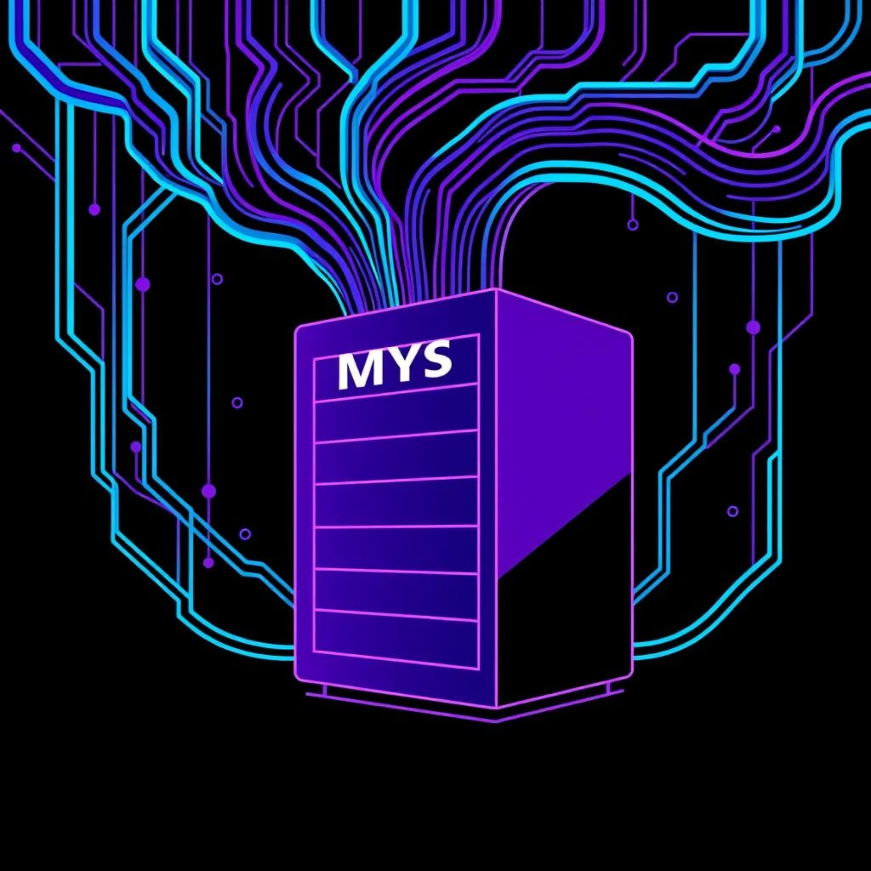
Technology Stack: Powering "Book My Stay"
Python: The Engine
MySQL: The Data Backbone
Business Logic & Interface: Python was chosen for its versatility, allowing rapid development of both core business logic and interactive user interfaces.
Robust Data Storage: MySQL provides a reliable and efficient relational database management system for storing all PG listings, user information, and booking details.
Flexibility & Scripting: Its extensive libraries and scripting capabilities ensure a flexible and scalable foundation for all application functionalities.
Scalability & Integrity: It ensures data integrity, security, and scalability, crucial for handling growing amounts of user and listing data.

Slide 5
Application Structure
Module Overview
User Module
Admin Module
Designed for tenants to search, browse, book, and manage their PG accommodations. Focuses on intuitive navigation and a seamless booking experience.
Equips PG owners and administrators with tools to manage listings, track bookings, and oversee overall operations. Emphasizes control and data management.
These two modules work in tandem to provide a comprehensive solution for PG accommodation management.

Slide 6





User Module Features: Your Stay, Your Control
Register & Login
Secure account creation and access for a personalized experience.
Browse Listings
Explore a wide array of PG options with detailed information.
Search & Filter
Refine searches by location, budget, amenities, and other preferences.
Book PG
Confirm and reserve preferred accommodations with ease.
View/Cancel Booking
Manage existing bookings, view details, and cancel if needed.

Slide 7
Admin Module Features: Streamlining Operations
Secure Login
Manage PG Listings
Authenticated access ensuring only authorized personnel manage the PG data.
Add new PGs, edit existing details, and remove outdated listings efficiently.
View User Bookings
Manage Availability
Access a comprehensive overview of all user bookings for tracking and management.
Update PG availability in real-time to reflect current occupancy and vacancies.

Slide 8

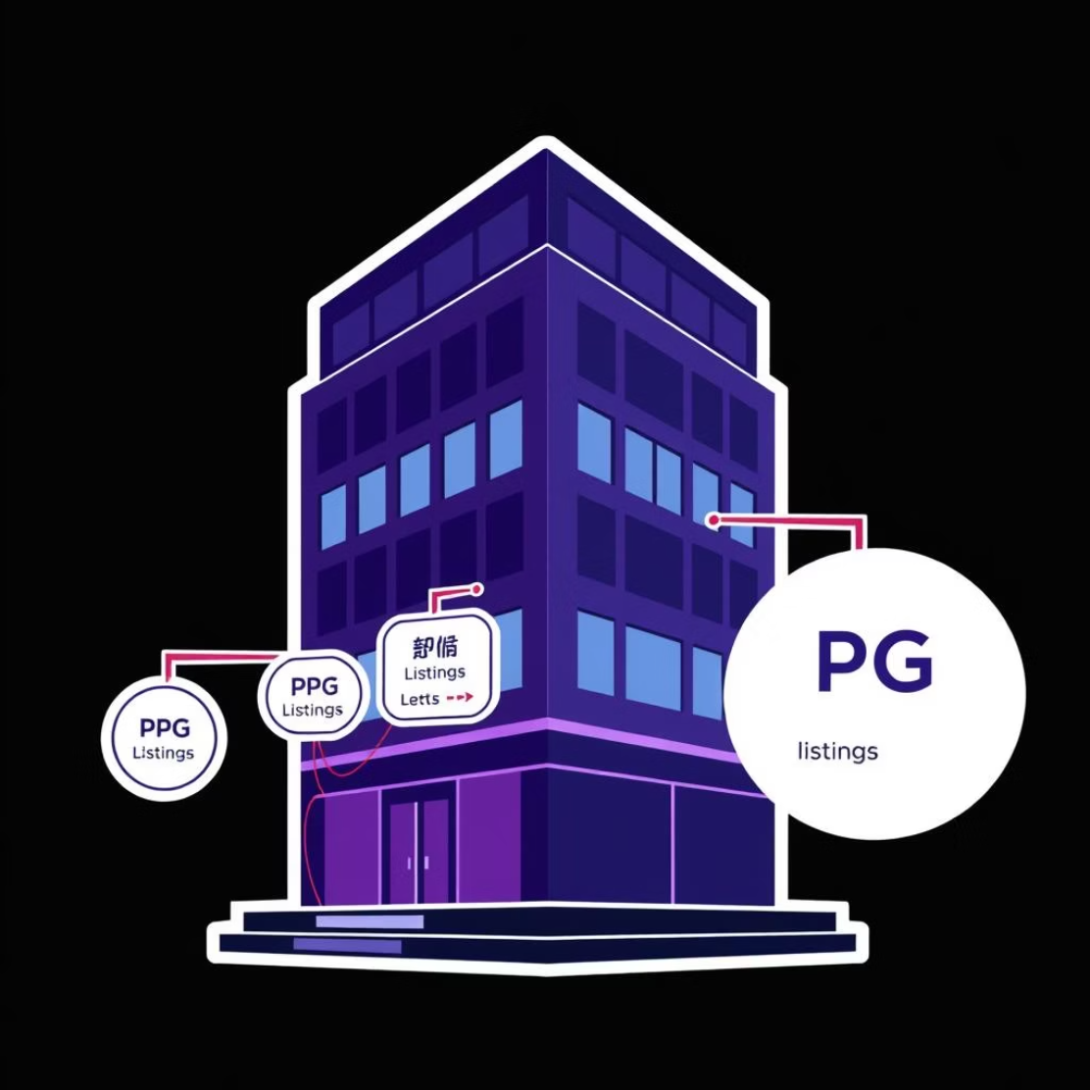

Database Design: Foundation of "Book My Stay"
Users Table
PG Listings Table
Bookings Table
Stores user registration details.
Contains detailed information about each PG.
Records all booking transactions.
Includes fields like UserID, Name, Email, Password, Contact.
Fields: PGID, Name, Location, Price, Amenities, Availability.
Attributes: BookingID, UserID, PGID, BookingDate, Status.
Ensures secure and unique user identification.
Enables comprehensive listing management.
Facilitates tracking and management of reservations.
These interconnected tables form the backbone of our system, ensuring data integrity and efficient retrieval.

Slide 9





System Workflow: User Journey
User Accesses App
Launches "Book My Stay" on their device.
Searches & Filters PG
Queries database for suitable accommodations.
Selects & Books PG
Booking details recorded in database.
Admin Manages
Admin confirms/updates PG availability via module.
User Views/Cancels
User interacts with their booking data.
This streamlined flow ensures efficient interaction between users, the application modules, and the MySQL database.

Slide 10

Conclusion & Future Scope
Key Outcomes & Skills Gained
Proficiency in Python Programming for application logic.
Expertise in Backend Development and data handling.
Seamless MySQL Database Integration and management.
Understanding User-Data Interaction and flow.
Effective Module Structuring for scalable applications.
Deployment on Localhost for testing and development.
Future Enhancements
Map Integration: Visualize PG locations on an interactive map.
Online Payments: Implement secure payment gateways for booking payments.
Email Notifications: Automated alerts for booking confirmations and updates.
Cloud Deployment: Transition to cloud platforms for wider accessibility and scalability.
"Book My Stay" is a robust foundation with significant potential for future growth and feature expansion.

Slide 11


